Slide 1
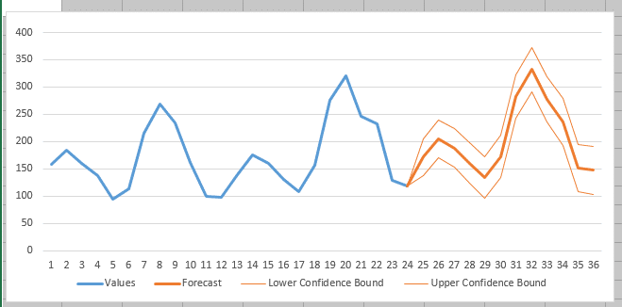
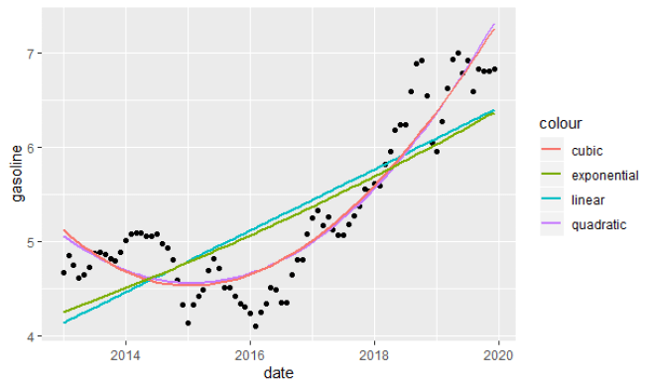
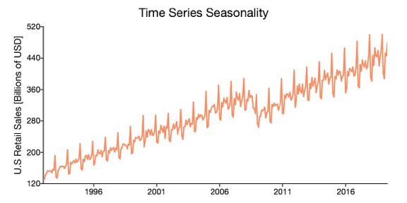
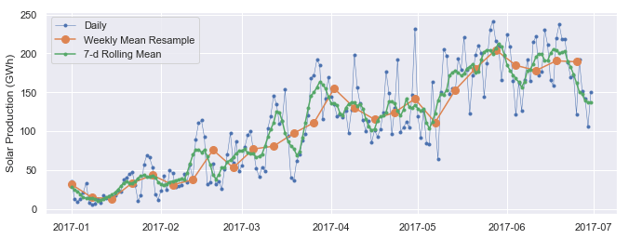
Time Series Forecasting

Slide 2
Forecasting methods
Tree-Based Ensemble with seasonality features (my favorite)
Qualitative, Naive (forecast = last value, or an average of last period)
Trend, Linear Regression,
Multivariate Linear Regression
Exponential Smoothing (weighted moving average)
Holt-Winters = Triple Exponential Smoothing (smooth, trend, seasonality)
Seasonality in the model using Fourier decomposition (over 4+ years)
ARMA (Auto-Regressive Moving Average), ARIMA (Auto-Regressive Integrated Moving Average) SARIMA (S=Seasonality), SARIMAX (X - eXogenous regressors)
Auto-correlations, bivariate cross-correlation, multivariate time series analysis
Causal (cause-effect) - modeling specific causes/drivers that can influence the target value (drivers – number of resources, spending on advertising, promotion, legal change, website redesign, sport event, new law, election, etc.). Some drivers cause permanent shift, others – temporary response.
Random Walk Simulation (Monte-Carlo) – when having causal model
Classification (Random Forest, Boosting, etc.) - "this type of event historically was causing ..."
Regression (Random Forest, Boosting, etc.) – predict stationary models ( with seasonality, but without trends)
Time series decomposition (separate trends, predict, then combine)
Neural Networks - LSTM (Long Short Term Memory), multivariate LSTM, GRU (Gated Recurrent Unit)
Facebook Prophet -
Azure AutoML -
AWS DeepAR - supervised learning algorithm, uses RNN (Recurrent Neural Network), uses 1 or multiple similar 1-dim time series.
etc.

Slide 3
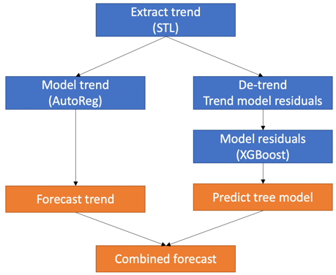
Trend + Ensemble-Tree Model
Idea - predict future values as function of (calendar) features.
1. Extract and forecast the trend separately.
2. Model the de-trended "static" data using date features.
3. Combine these two models
Extract features from Date/Time:
Day of week, month, quarter, year
Month of year
Quarter of year
Hour of day, week, month, year
Minute of hour, day
AM/PM
Holiday/special event
Business-specific process/change
Note - some features are cyclic and can be transformed to a trigonometric scale
Train the regressor using this features.
( best – sklearn HistGradientBoostingRegressor )
For any future date we know the features – thus we can predict the value.
Add forecasted value of the trend to get the final prediciton.
Time series forecasting: calendar features + ensemble tree model
https://www.youtube.com/watch?v=n3OWVkXJmHE
https://www.youtube.com/watch?v=5GcCzKvrI1U
https://www.youtube.com/watch?v=vV12dGe_Fho

Slide 4
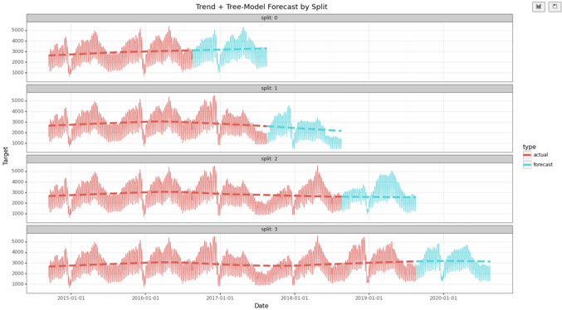
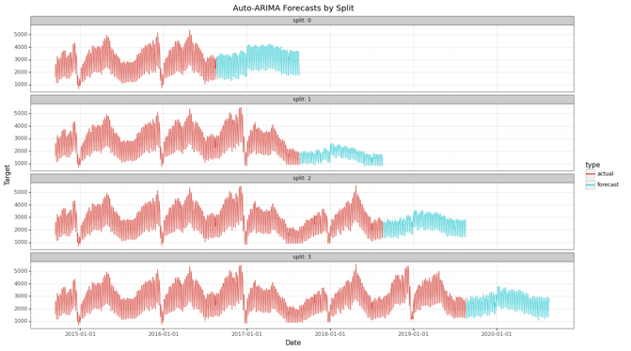
Forecasting Example
Two models – Trend + Ensemble-Tree model vs Auto-ARIMA (SARIMAX)
Method | Avg Error (across 4 splits) | Avg Train Time (across 4 splits)
Trend + Tree-Model | 14.6% | ~2sec
Auto-ARIMA (SARIMAX) | 21.6% | ~2min

Slide 5
Forecasting in Power BI
Holt-Winters’ multiplicative method (~ 1960)
Power BI uses exponential smoothing and backtesting (hindcasting).
There are two algorithms:
a variation of the Holt-Winters algorithm for the seasonal data with a few changes to deal with noisy data
a simpler model for non-seasonal data which has a term for additive trend and additive error
For the seasonal forecasting, PBI modify the Holt-Winters algorithm by computing the sum of squares of prediction errors for what is called a validation window, instead of using the one-step ahead.
Another modification they make is when they detect large variations, they adjust the trend of the time window to a more recent to capture the overall trend of the time series.
... https://otexts.com/fpp2/holt-winters.html -
... https://powerbi.microsoft.com/es-es/blog/describing-the-forecasting-models-in-power-view/#ETSAAA -
... https://powerbi.microsoft.com/en-us/blog/introducing-new-forecasting-capabilities-in-power-view-for-office-365/ -
... https://stoneridgesoftware.com/take-advantage-of-forecasting-in-power-bi-with-the-analytics-pane/ - ... https://pawarbi.github.io/blog/forecasting/python/powerbi/forecasting_in_powerbi/2020/04/24/timeseries-powerbi.html – ... https://pawarbi.github.io/blog/forecasting/python/powerbi/forecasting_in_powerbi/2020/04/24/timeseries-powerbi.html#ETS(AAN) -

Slide 6
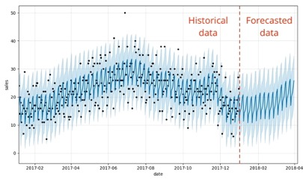
Forecasting using Facebook Prophet
.. https://github.com/facebook/prophet -
.. https://youtu.be/pOYAXv15r3A - (video)
.. https://facebook.github.io/prophet/docs/quick_start.html -
.. https://databricks.com/blog/2020/01/27/time-series-forecasting-prophet-spark.html -
.. Forecasting time series data based on an additive model where non-linear trends are fit with yearly, weekly, and daily seasonality, plus holiday effects.
.. It works best with time series that have strong seasonal effects and several seasons of historical data.
.. Prophet is robust to missing data and shifts in the trend, and typically handles outliers well.
Neural Prophet
.. https://towardsdatascience.com/neural-prophet-a-time-series-modeling-library-based-on-neural-networks-dd02dc8d868d -
.. https://github.com/ourownstory/neural_prophet -
.. Much faster than Prophet, uses PyTorch - https://pytorch.org/ , uses AR-Net for modeling time-series autocorrelation .. https://ai.facebook.com/blog/ar-net-a-simple-autoregressive-neural-network-for-time-series/ -
.. Custom losses and metrics, configurable non-linear layers of feed-forward neural networks, etc.
black dots - actuals
dark blue - predictions
light blue - 95% uncertainty intervals
The input to Prophet is always a dataframe with two columns: ds and y.
The ds (datestamp) column should be of a format expected by Pandas, ideally YYYY-MM-DD for a date or YYYY-MM-DD HH:MM:SS for a timestamp.
The y column must be numeric, and represents the measurement we wish to forecast.

Slide 7
Forecasting Using Azure AutoML
or MSFT Time Series in SQL Server
AutoML Wizard - https://docs.microsoft.com/en-us/azure/synapse-analytics/machine-learning/tutorial-automl
Microsoft Time Series in SQL Server
- https://www.sqlshack.com/microsoft-time-series-in-sql-server/

Slide 8
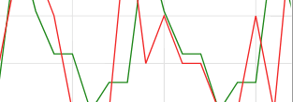
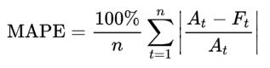
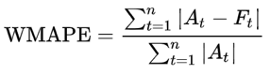
Model Quality Evaluation
Multiple Ways to Calculate Forecast Accuracy: https://www.callcentrehelper.com/calculate-forecast-accuracy-113808.htm
MAPE = Mean Absolute Percentage Error
(A = Actual, F = Forecast)
Note: the 100% multiplier is optional
example – actual (green) vs forecast (red)
WMAPE = Weighted MAPE
*100%
Normalization can be done in different ways:
by difference between maximum and minimum
by standard deviation of the "actual" curve
by mean value - not good, error will depend on vertical shift
by interquartile range (i.e. the difference between 25th and 75th percentile) – not good, depends on distribution of points between quartiles
Real life error function should be custom fit to your data and business case.
And normalization should not depend only on min/max or mean – but probably on combination of different characteristics – and treat "zero" cases carefully.
Other methods:
MSE = Mean Squared Error
RMSE = Root Mean Square Error
NMAPE – Normalized MAPE
NRMSE – Normalized RMSE
R2 score
Spearman Correlation
etc.

Slide 9
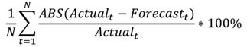
Time Series Forecast Error Estimation
Normalization should not depend only on min/max or mean, but probably on combination of different characteristics, and treat "zero" cases carefully.
For example, look at this MAPE normalization formula:
F
F - A
------- = infinity
A
A
0
If some points approach zero, the whole sum goes to infinity and invalidates the error estimate.
If we have two curves behaving in a similar manner, but one of them is closer to zero, the error for this curve will by much higher.
We can try to avoid this instability by shifting the whole time series up ot down – away from zero. But then the error estimate will depend on the value of this shift.
If we normalize by the amplitude of "oscillations", then we may have an infinity problem again when the oscillations are very small.
F
Same (A-F),
but different MAPE
A
F
A
0

Slide 10
Time Series Forecast Error Estimation
def fin_err(actual,
predicted,
norm=None,
err_type='mae', # mae or rmse
noise_level_relative=1e-2,
noise_level_absolute=1e-2,
max_error=1e2):
Na, Np = len(actual), len(predicted)
if Na == 0 or Np == 0 or Na != Np:
return np.nan
np_act = np.array(actual, dtype = np.float64)
np_pre = np.array(predicted, dtype = np.float64)
if err_type == 'mae': # Mean Absolute Error
myerr = np.abs(np_act - np_pre).sum() / Na
elif err_type == 'rmse': # Root Mean Square Error
myerr = math.sqrt(mean_squared_error(np_act, np_pre))
else:
print("ERROR: err_type should be 'mae' or 'rmse', exiting ...")
sys.exit(1)
if norm and norm > 0: # normalize - and limit
return min (max_error, myerr / norm )
v_max_act, v_min_act = np.max(np_act), np.min(np_act) # max min
v_max_pre, v_min_pre = np.max(np_pre), np.min(np_pre) # max min
v_amp_act = v_max_act - v_min_act # amplitude
v_amp_pre = v_max_pre - v_min_pre # amplitude
v_level_act = np.abs(np_act).sum() / Na # level
v_scale_act = max(v_level_act, v_amp_act) # level
v_level_pre = np.abs(np_pre).sum() / Na # scale
v_scale_pre = max(v_level_pre, v_amp_pre) # scale
if (v_scale_act <= noise_level_absolute and
v_scale_pre <= noise_level_absolute):
return 0 # actual and predicted are both close to zero
denom_min = max(v_scale_act * noise_level_relative,
noise_level_absolute)
if v_scale_act > denom_min :
denom = v_scale_act
else:
denom = denom_min
return min (max_error, (myerr / denom))
We have designed special function fin_err()
to overcome the "infinity" and instability problems.
.. https://github.com/lselector/ml_ai_doc/blob/master/ML_Time_Series_Forecasting_Error.pptx
.. https://github.com/lselector/statistics/blob/master/nb_Time_Series_Forecast_Error.ipynb
The fin_err() function has optional optimization parameters.
By default they are tuned for financial data.
Note – this function doesn't use the 100% multiplier.
Terminology:
level = average absolute value
amplitude = max_val – min_val ( amplitude of oscillations )
scale = max( amplitude , level )
We use theabove defined "scale" to normalize the error.
For example, if the values are oscillating in range [-95,95], then
level ~100,
amplitude ~10,
scale = max(100,10) = 100.
To avoid dividing by zero, function calculates
the minimum positive denominator value.
It also limits the output error (to 100).

Slide 11
Comparing fin_err() and mape() error functions
As you can see, mape() gives unreasonable errors on lines 0, 1, 2,4,5.
fin_err() is much more stable.

Slide 12
Comparing fin_err(), mape(), R2, and Spearman Correlation error functions
The image shows results of multiple error estimation depending on the type of the curve, distance from zero, and the presence of a trend.
You may see that R2 Correlation and Spearman Correlation are only good (close to 1) when we have a clear linear trend.
Also compare MAPE and FIN, you see that FIN (fin_err() – blue) is much more stable than MAPE.

Slide 13
More Details about different forecasting models

Slide 14
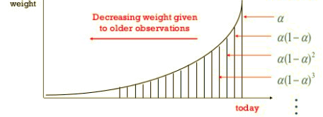
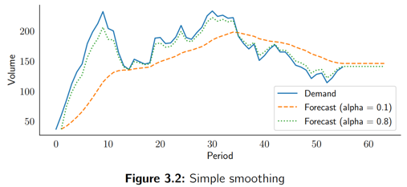
Exponential Smoothing
Exponential Smoothing - a weighted moving average,
where weights decline exponentially for older events.
If x(t) is real time series, then we construct forecast f(t)
step by step using formula:
f_{t+1} = a*x_{t} + (1-a)*f_{t}
We initiate f₀ as an average of first several points.
For future points (once we out of historical period) we simply extrapolate last value into the future.
Limitations of simple exponential smoothing model:
it does not project trends
it does not recognize seasonal patterns
it cannot use any external information
Good simple explanations by Nicolas Vandeput:
.. https://towardsdatascience.com/simple-exponential-smoothing-749fc5631bed
Python code:
.. https://towardsdatascience.com/diy-simple-exponential-smoothing-with-python-dbb570d30fb5

Slide 15
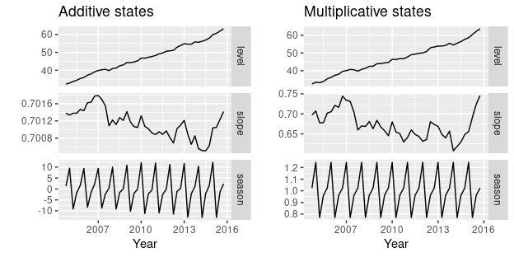
Holt-Winters = Triple Exponential Smoothing
Holt-Winters = Triple Exponential Smoothing
1st smoothing (level) -exponential smoothing for value
2nd smoothing (trend) - exponential smoothing for slope
3rd smoothing - exponential smoothing comparing to previous cycle
.. https://towardsdatascience.com/holt-winters-exponential-smoothing-d703072c0572 -
.. https://orangematter.solarwinds.com/2019/12/15/holt-winters-forecasting-simplified/ -
additive method
The additive method is preferred when the seasonal variations are roughly constant through the series, while the multiplicative method is preferred when the seasonal variations are changing proportional to the level of the series.
With the additive method, the seasonal component is expressed in absolute terms in the scale of the observed series, and in the level equation the series is seasonally adjusted by subtracting the seasonal component.
Within each year, the seasonal component will add up to approximately zero.
With the multiplicative method, the seasonal component is expressed in relative terms (percentages), and the series is seasonally adjusted by dividing through by the seasonal component. Within each year, the seasonal component will sum up to approximately m .
multiplicative method

Slide 16
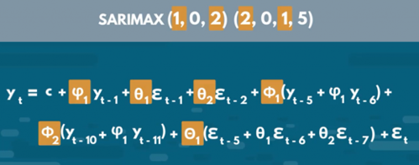
AR, MA, ARMA, ARIMA, ARIMAX, SARIMAX
AR = Auto-Regressive (next point as linear combination of several previous) Y_forward1 = B0 + B1*Y + B2*Y_lag1 + ...
MA = Moving Average Y = B0 + B1*E_lag1 + B2*E_lag2 + ... + Bn*E_lagn , where "E" = residual errors (which change as we iteratively train the model)
"I" = Integrated (use differences to remove trend while modeling): Y_forward1 - Y = B0 + B1*(Y - Y_lag1) + B2*(Y_lag1 - Y_lag2) + ...
ARMA = AR + MA = Auto Regressive Moving Average model
ARIMA = AR + I + MA = Auto-Regressive Integrated Moving Average model
"X" = eXogenous variables (additional variables, think "multivariate regression")
ARIMAX = ARIMA with exogenous variables. An exogenous variable is a covariate that influence the observed time-series values
SARIMAX = Seasonal ARIMAX – includes seasonal factors
ACF = Auto-Correlation Function
PACF = Partial ACF
.. https://people.duke.edu/~rnau/411arim.htm
ARIMA(p, d, q) = ARIMA (AR, I, MA)
p = number of lagged values in AR model (number of autoregressive terms)
d = order of differencing (used for stationarity)
q = number of lagged errors in MA model
ARIMA(1,0,0) - 1st order autoregressive model
ARIMA(2,0,0) - oscillations
ARIMA(0,1,0) - random walk
ARIMA(1,1,0) - differenced first-order autoregressive model
ARIMA(0,1,1) - simple exponential smoothing:
ARIMA(0,1,1) - simple exponential smoothing with growth
ARIMA(1,1,1) - ...
ARIMA(0,2,1) - linear exponential smoothing
ARIMA(0,2,2) - linear exponential smoothing
Great explanation: .. https://towardsdatascience.com/understanding-arima-time-series-modeling-d99cd11be3f8
More links:
.. https://en.wikipedia.org/wiki/Autoregressive%E2%80%93moving-average_model
.. https://en.wikipedia.org/wiki/Autoregressive_integrated_moving_average
.. https://www.statsmodels.org/dev/examples/notebooks/generated/statespace_sarimax_stata.html
.. https://365datascience.com/tutorials/python-tutorials/sarimax/
.. https://people.duke.edu/~rnau/411arim.htm
Autoregressive Model: - https://www.youtube.com/watch?v=5-2C4eO4cPQ -
Autocorrelation and Partial Autocorrelation - https://www.youtube.com/watch?v=DeORzP0go5I -
ACF and PACF:
- https://towardsdatascience.com/significance-of-acf-and-pacf-plots-in-time-series-analysis-2fa11a5d10a8
SARIMAX

Slide 17
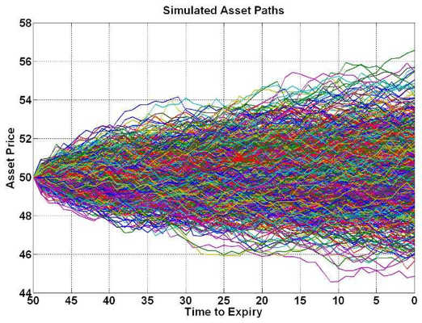
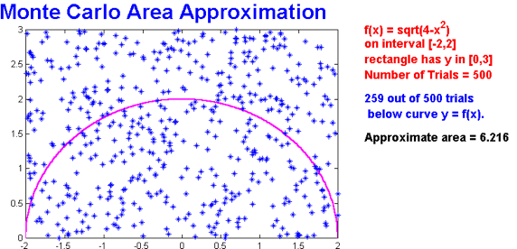
Monte Carlo Examples:
In the example above relative error is ~1/sqrt(N)
= 1/sqrt(259.0) = 0.062 (or ~6%)
MCMC – Markov Chain Monte Carlo (random walk)

Slide 18
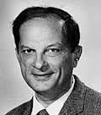
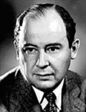
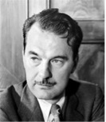

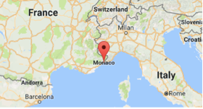

What is “Monte Carlo” ?
Monte Carlo method - use random sampling to obtain numerical results. It was invented in the late 1940s by Stanislaw Ulam, while he was working on nuclear weapons projects at the Los Alamos National Laboratory.
Nicholas Metropolis has suggested using the name Monte Carlo, which refers to the Monte Carlo Casino in Monaco.
Monte Carlo officially refers to an administrative area of the Principality of Monaco, specifically the ward of Monte Carlo/Spélugues, where the Monte Carlo Casino is located.
Casino’s name “Monte Carlo” means literally "Mount Charles”. It was chosen in 1863 in honor of Charles III, Prince of Monaco.
Stanislaw Ulam
John von Neuman
Nicholas Metropolis

Slide 19
Time series forecasting with Multiple Linear Regression
Use multi-dimensional linear regression to get coefficients of the model.
.. Take quarterly values (or monthly values) – and put them into separate columns.
This way we have multiple time serieses
.. Model trend as a polynomial function – need to tune coefficients.
We use regular linear regression model to find best fit and find coefficients.
Here is a nice description with Python code:
- https://www.youtube.com/watch?v=td9QLuijh9c

Slide 20
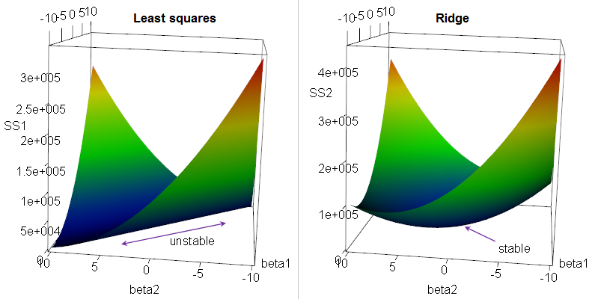
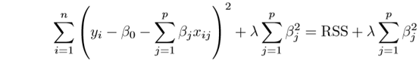
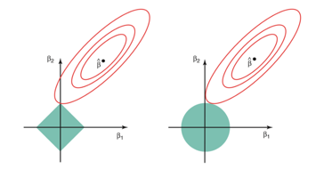
Regression: Ridge, LASSO, Elastic Net
Multivariate (multiple) Linear Regression Regularization.
Suppose we have a OLS (Ordinary Linear Squared) regression where two parameters x1 & x2
are not orthogonal, but in fact highly correlated.
Then there may be is infinite number of coefficients which will fit the model.
For example, (x1 - x2), (10*x1 - 10*x2), (100*x1 - 100*x2), etc.
If we are trying to minimize the cost function in the multidimensional
space of coefficients, we will get an infinite diagonal groove (ridge) for x1=x2.
Any place at the bottom of this ridge is equally good for us.
So we will get a big variability in possible values of coefficients for x1 & x2.
The solution will be unstable.
We can reduce this variability by adding additional regularization factor like this:
Why Ridge Regression is called Ridge ...
When we minimizing this expression, bigger "lambda" value will cause smaller "beta" values, thus keeping the coefficients "beta" from becoming too large.
This is called "Ridge Regression". It changes the infinitely long ridge into a local minimum.
In Ridge Regression we add a "regularization" term as sum of squares (L2 norm).
If instead we use L1 norm (sum of abs values) - it is called "LASSO Regression",
where LASSO = Least Absolute Shrinkage and Selection Operator.
LASSO favors solutions on the tips of the bounding surface for coefficients, where some of coefficients are zero. Thus it favors "sparse" solutions.
A combination of Ridge Regression and LASSO Regression is called "Elastic Net"
Why LASSO favors sparse solutions

Slide 21
Multivariate Forecasting Using LSTM
Multivariate Time Series Forecasting with LSTMs in Keras (2020) - by Jason Brownlee
- https://machinelearningmastery.com/multivariate-time-series-forecasting-lstms-keras/
Time Series Prediction With Deep Learning in Keras (2020) - by Jason Brownlee
- https://machinelearningmastery.com/time-series-prediction-with-deep-learning-in-python-with-keras/
Neural networks for algorithmic trading. Multivariate time series (2017)
- https://medium.com/machine-learning-world/neural-networks-for-algorithmic-trading-2-1-multivariate-time-series-ab016ce70f57
Energy Demand Time Series Forecasting (2017)
- https://github.com/Azure/MachineLearningSamples-EnergyDemandTimeSeriesForecasting

Slide 22
XGBoost for Time Series Forecasting
"""
XGBoost can be used for time series forecasting, although it requires that the time series dataset be transformed into a supervised learning problem first.
It also requires the use of a specialized technique for evaluating the model called walk-forward validation, as evaluating the model using k-fold cross validation would result in optimistically biased results.
"""
- Jason Brownlee
https://machinelearningmastery.com/
Here are some links with python code:
- https://machinelearningmastery.com/xgboost-for-time-series-forecasting/ -
- https://www.kaggle.com/getting-started/48536 -
- https://towardsdatascience.com/using-gradient-boosting-for-time-series-prediction-tasks-600fac66a5fc
# finalize model and make a prediction for monthly births with xgboost
from numpy import asarray
from pandas import read_csv
from pandas import DataFrame
from pandas import concat
from xgboost import XGBRegressor
# transform a time series dataset into a supervised learning dataset
def series_to_supervised(data, n_in=1, n_out=1, dropnan=True):
n_vars = 1 if type(data) is list else data.shape[1]
df = DataFrame(data)
cols = list()
# input sequence (t-n, ... t-1)
for i in range(n_in, 0, -1):
cols.append(df.shift(i))
# forecast sequence (t, t+1, ... t+n)
for i in range(0, n_out):
cols.append(df.shift(-i))
# put it all together
agg = concat(cols, axis=1)
# drop rows with NaN values
if dropnan:
agg.dropna(inplace=True)
return agg.values
# load the dataset
series = read_csv('daily-total-female-births.csv', header=0, index_col=0)
values = series.values
# transform the time series data into supervised learning
train = series_to_supervised(values, n_in=6)
# split into input and output columns
trainX, trainy = train[:, :-1], train[:, -1]
# fit model
model = XGBRegressor(objective='reg:squarederror', n_estimators=1000)
model.fit(trainX, trainy)
# construct an input for a new preduction
row = values[-6:].flatten()
# make a one-step prediction
yhat = model.predict(asarray([row]))
print('Input: %s, Predicted: %.3f' % (row, yhat[0]))

Slide 23
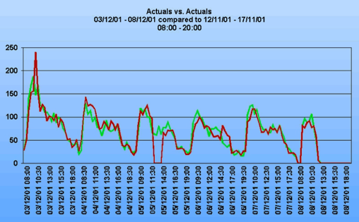
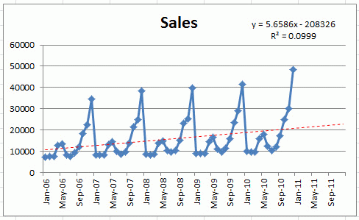
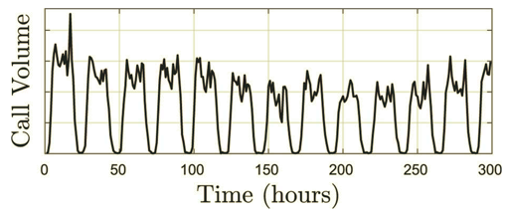
Call volume predictions
Forecasting calls volume is a common problem:
- Customer service call volume by day (or part of day)
- EMS (Emergency Medical Services) calls
- Sales calls volume
- Virtual Machine Usage in the cloud
- predictions in investments & insurance
- etc.
Balance between service quality (short waiting times, few
abandonments) and service efficiency (utilization of agents).
variations and trends in call volume depend on various parameters - like time of day, day of week, seasonal, trends (within year and growth between years), special events (holidays, promotions, legal changes, sport events, etc.). Number of calls can vary dramatically between days (x5 times or more)
Variations within one month
Seasonal variations repeating year after year

Slide 24
"""If you've ever stepped into a call center the morning after an unannounced marketing campaign, you likely came to the painful realization that the marketing folks need to be tightly integrated into this process.
So, too, the people in legal who change terms and conditions; the people in IT who make system changes; and anybody else who impacts the call center's work load.
A cross-functional meeting (minimum once per week) is essential.
The motto of this team: No surprises! """
from "Improving Your Call Center's Workload Forecast" (2003)
- https://www.eetimes.com/document.asp?doc_id=1196835

Slide 25
Some Links
Workload Forecasting For A Call Center: Methodology And A Case Study (2009)
- https://arxiv.org/pdf/1009.5741.pdf
How to Choose the Right Forecasting Technique (1971)
- https://hbr.org/1971/07/how-to-choose-the-right-forecasting-technique
Example of an Excel youtube demo of forecasting,
- https://www.youtube.com/watch?v=IKwl6CEwQxQ
How to Calculate Forecast Accuracy (2017)
- https://www.callcentrehelper.com/calculate-forecast-accuracy-113808.htm
Daily volume of cases in emergency call centers: construction and validation of a predictive model (2017)
- https://www.ncbi.nlm.nih.gov/pmc/articles/PMC5576313/
Neural networks for algorithmic trading. Multivariate time series
- https://medium.com/machine-learning-world/neural-networks-for-algorithmic-trading-2-1-multivariate-time-series-ab016ce70f57
Energy Demand Time Series Forecasting
- https://github.com/Azure/MachineLearningSamples-EnergyDemandTimeSeriesForecasting

Slide 26

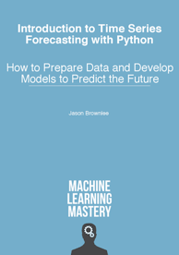
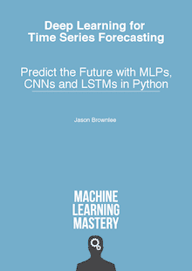
Jason Brownlee
Best two books on time series forecasting:
Jason Brownlee
Melbourne, Australia
Jason wrote 21 books on Machine Learning.
I highly recommend to buy all of them.
They come as PDF with separate python code files.
https://www.linkedin.com/in/jasonbrownlee/
https://machinelearningmastery.com/
https://SuperFastPython.com
Introduction to Time Series Forecasting With Python
Deep Learning for Time Series Forecasting

Slide 27

Multivariate time series
Multivariate time series has more than one time-dependent variable. Each variable depends not only on its past values but also has some dependency on other variables. This dependency is used for forecasting future values
How to Develop Multivariate Multi-Step Time Series Forecasting Models for Air Pollution - by Jason Brownlee , 2019, in Deep Learning for Time Series
- https://machinelearningmastery.com/how-to-develop-machine-learning-models-for-multivariate-multi-step-air-pollution-time-series-forecasting/
Jason provides Python code to run and compare multiple models:
from sklearn.neighbors import KNeighborsRegressor
from sklearn.tree import DecisionTreeRegressor
from sklearn.tree import ExtraTreeRegressor
from sklearn.svm import SVR
from sklearn.ensemble import AdaBoostRegressor
from sklearn.ensemble import BaggingRegressor
from sklearn.ensemble import RandomForestRegressor
from sklearn.ensemble import ExtraTreesRegressor
from sklearn.ensemble import GradientBoostingRegressor
Jason Brownlee
CNNs, LSTMs, Multivariate Forecasting, Multi-Step Forecasting
Multivariate time series forecasting
(using VAR = Vector Autoregression)
https://towardsdatascience.com/multivariate-time-series-forecasting-653372b3db36
import pandas as pd
import statsmodels.api as sm
from statsmodels.tsa.api import VAR
macrodata = sm.datasets.macrodata.load_pandas().data
data = macrodata.iloc[:, 2:4]
data.tail(2)
model = VAR(data)
model_fit = model.fit()
pred = model_fit.forecast(model_fit.y, steps=1)
print(pred)
Multiple Time Series Forecasting With Scikit-Learn
(using RandomForestRegressor)
- https://www.youtube.com/watch?v=RRd2wzMRpOc

Slide 28
Call volume predictions
variations in call volume depending on:
- time of day
- day of week
- special outliers (holiday, elections, sport, competitive actions, strikes, promotions, etc.)
- seasonality - cyclical patterns that repeat any two or three years or more.
- trends in the data (within year, between years).
- growth rates of these trends.
How number of calls is measured? Corrections on dropped calls
oscillations (auto-regression)
ARMA models (Auto Regressive Moving Average)
Time-series approach:
- apply corrections for trends, outliers, variations (listed above)
- calculate regression (logistic better than linear)
- revert corrections, apply known events (promotions, ...)
which may have effect going forward
Data: raw observations, hourly totals, 3-point moving average smoothing, trends
Types of calls: sales, customer service, troubleshooting, etc.
Columns for multivariate forecasting:
- date
- hour (or part of day: overnight, early morning, prime time, etc.)
- Holiday (yes / no)
- Day of the week
- Season (Fall, Winter, Spring, Summer)
- Month
- Calendar Week (instead of Season?)
- billing cycle (or/and day within cycle)?
- new services/promotions introduced recently (several columns)
- legal term changes (confuse people)
- website changes (confuse people)
=======
- Number of calls category 1, category 2, etc.
- Number of emails, website traffic, calls for automatic service
(IVR = Interactive Voice Response), other platforms
- Numbers from previous years (increase over years for this particular day, week, season, etc.)
- Number of new clients signed in previous 1-2 weeks
- DJIA (Dow Jones Industrial Average, S&P 500, VIX, etc.)
- unemployment rate, rate on personal loans
- volume of news, tweets, google searches, Wikipedia views
- volume of calls in other companies or gov. organizations
- demographics (number of people entering certain age groups in certain income categories)
- Investor Sentiment analysis
- tax events, cash-flow budget(s)
- competitive pricing, events, merges, etc.
- expert opinion column (manual adjustment)

Slide 29
Multivariate time series (continued)
AWS DeepAR Forecasting Algorithm (using RNN).
In many applications, however, you have many similar time series across a set of cross-sectional units. For example, you might have time series groupings for demand for different products, server loads, and requests for webpages.
For this type of application, you can benefit from training a single model jointly over all of the time series.
DeepAR takes this approach.
https://docs.aws.amazon.com/sagemaker/latest/dg/deepar.html
Overview of Time Series Forecasting from Statistical to Recent ML Approaches
https://medium.com/@phylypo/overview-of-time-series-forecasting-from-statistical-to-recent-ml-approaches-c51a5dd4656a
How To Predict Multiple Time Series At Once With Scikit-Learn
https://www.mariofilho.com/how-to-predict-multiple-time-series-with-scikit-learn-with-sales-forecasting-example/
TimeSeries-Multivariate – notebook on Kagle, using Keras
https://www.kaggle.com/lokeshkumarn/timeseries-multivariate
Credits to Jason https://machinelearningmastery.com/multivariate-time-series-forecasting-lstms-keras/

